Slide 1
Youth Drug Use Analysis Using Decision Tree
Report By: Hrishabh Kulkarni
Professor: Dr. Ariana Mendible

Slide 2
About:
There was a National survey done on Drug Use And Health by National Survey on Drug Use and Health (NSDUH) full dataset is publicly available
Mission
Analysis on three different drug type using Decision Tree Methods and Ensemble Learning Methods.
Dataset Contents
Demographics
Parental Behaviors
Personal Experiences
Social Influences

Slide 3
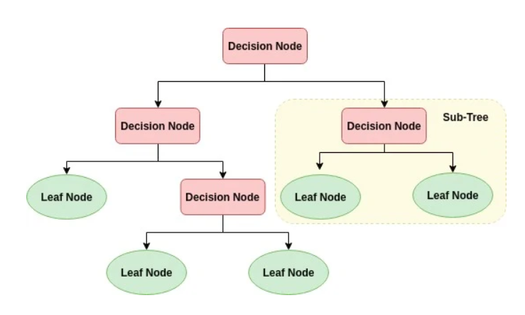
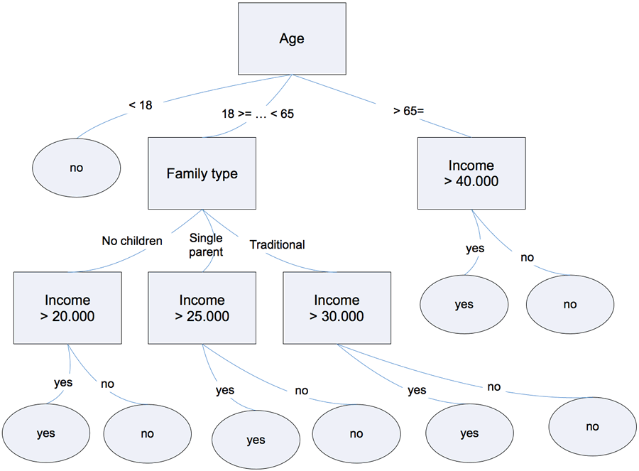
Theoretical Discussion
DECISION TREE
Recursively splits data into nodes based on feature thresholds.
Parameters: minsplit, max_depth, subset helps maximize tree depth
BAGGING
Trains multiple trees on bootstrapped data as on averages predictions.
Mtry is all features considered per split, (all value of predictors).
oob_score samples used for validation, called out-of-bag.
RANDOM FOREST
Same as bagging but selecting random feature subsets per split.
mtry is sqrt(p) for classification and p/3 for regression.
N_tress or n_estimators for no. of tress.
BOOSTING
Sequentially builds trees to correct errors of prior models.
It does is weighted voting.
Max_depth & Shrinkage help to maximize and reduce each tree’s support.

Slide 4
MODELS | Binary Classification | Multi-Class Classification | Regression
KEY QUESTIONS | Predict whether a youth has ever used marijuana (binary: Yes/No) based on demographics, youth experiences, and peer/parental influences? | How frequently do youths use alcohol (Seldom, Sometimes, Frequent) based on their social environment and demographics? | What is the best factors to predict the number of days a youth has used cigarettes in the past 30 days (continuous count)?
TARGET VARIABLE | Marijuana Use | Alcohol Days | Cigarette Usage Days
PREDICTORS | Parental Disapproval School Punishment Group Fights Friends Use Marijuana Friends Offered Marijuana Parents Use Marijuana | Physical Fights Grades Gender Race Income School Safety | Parents Smoke Physical Fights Stolen Items Friends Smoke Poverty Level

Slide 5
Data Cleaning and Pre-processing
Hyperparameter Tuning
Cleaned data by removing NAs and ensuring balanced splits (70% training, 30% testing).
Handled class distribution (based on Drinker)
Seldom - Class 0 (for 1 & 2)
Sometime - Class 1 (for 3)
Frequent - Class 2 (for 4 & 5)
Used createDataPartition() (splitting data into training and testing sets.)
Implemented factor and numeric conversion for classification & regression.
Decision Tree:
cp (0, 0.01)
minsplit (10)
Bagging and Random Forest:
mtry (p for bagging, SQRT(p) for RF
ntree (500)
Boosting:
n.trees (1000)
shrinkage (0.01, 0.001)
interaction.depth (4)

Slide 6
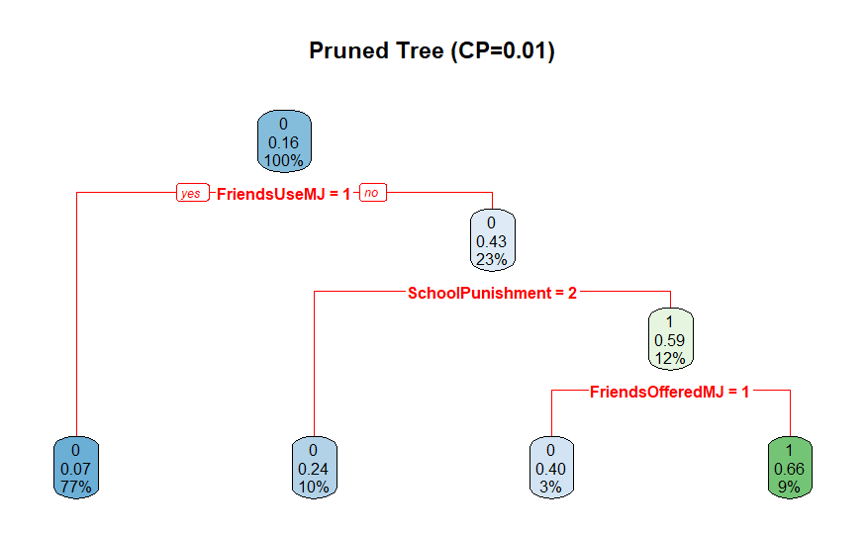
Discussion 1 Describe flow of one of basic tree models. Choose one noteworthy end node, trace path to it discussing its interpretation.
The pruned decision tree predicts whether a youth has used marijuana (Yes/No) based on key factors:
Conditions:
Friends Use Marijuana
School Punishment
Friends Offered Marijuana
Findings:
Peer Influence Dominates:
The strongest predictor is Friends Use MJ. If friends use it, the model predicts 100% likelihood of youth use. Even when friends don’t use, offers from friends still increase risk (12% as Yes).
School Punishment Mitigates Risk:
Youths facing moderate school punishment (School Punishment = 2) are 77% likely to avoid use, suggesting disciplinary policies may deter experimentation.

Slide 7
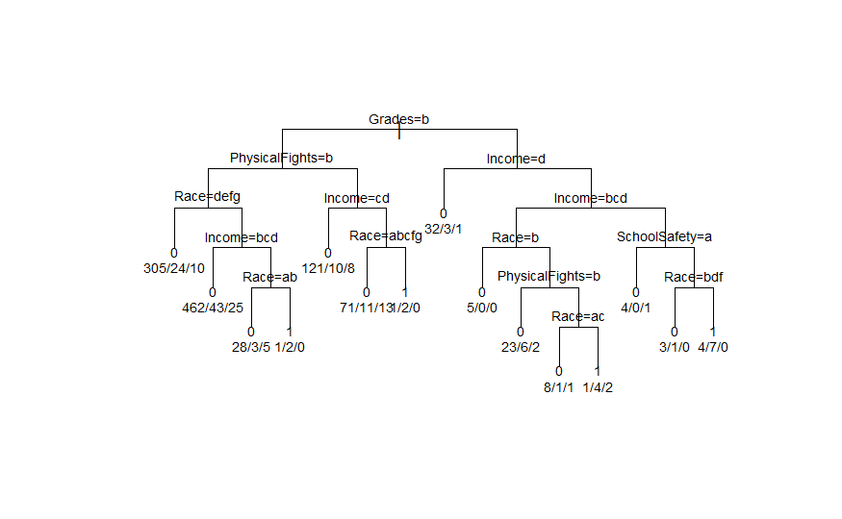
Discussion 2 Describe flow of one of your basic tree models. Choose one noteworthy end node, trace the path to it and discuss its interpretation
Selected Path: Highest‐Frequent Node (1 / 5 ~ 20 % Frequent Drinking)
Path Trace
Root Node: Grades = b (mid‑range academic performance)
2nd Split: Income ∈ {b,c,d} (middle‑income households)
3rd Split: SchoolSafety = a (students feel very safe at school)
4th Split: Race ∈ {b,d,f} (specific demographic grouping)
End Node: 5 students → 4 Seldom, 0 Sometimes, 1 Frequent → 20 % frequent drinkers
Observations
This small subgroup combines moderate grades with middle income and high perceived school safety.
Their demographic profile (Race ∈ {b, d, f}) coincides with the highest relative rate of frequent drinking.
Even within a safe school environment, a niche cluster still progresses to frequent use.

Slide 8
Discussion 3 How do the predictions change using into binary, ordinal (categorical and ordered), and numerical variables data type? What is each telling you, and when is it appropriate to use each?
 | Binary Variables | Ordinal Variables | Numerical Variables
Example | Friends Use MJ: 0/1 | School Punishment: 1=None, 2=Moderate, 3=Strict | Days Offered MJ: 0-30 count
Insights | Distinct split: Yes/No | Captures intensity/degree/level | Precise frequency/quantity measurements
Appropriate Usage | presence/absence of a factor is most important | Meaningful thresholds | Exact quantities/frequency

Slide 9
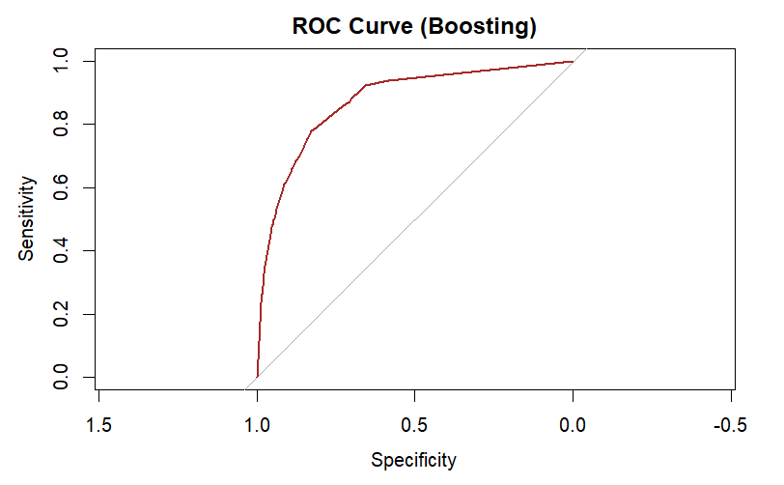
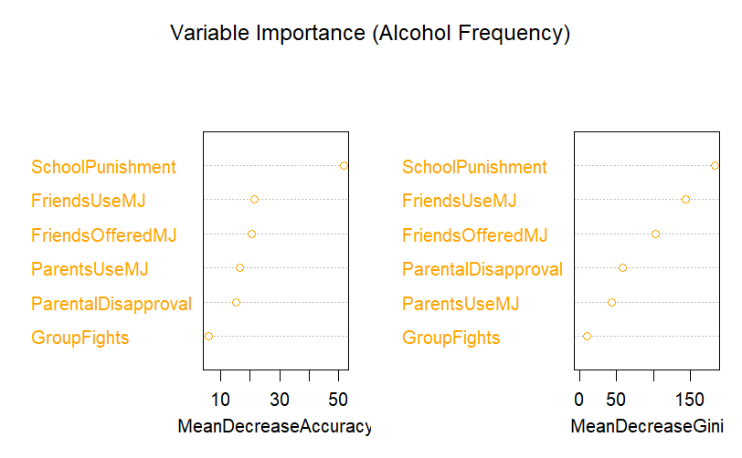
Binary Classification - Model Comparison
Predicting Marijuana Use (Yes/No)
Model | Accuracy (%) | Precision (%) | Recall (%) | F1 (%) | AUC (%) | OOB Error (%) | Specificity (User) (%) | Top Predictors
Decision Tree | 87.99 | 65.87 | 47.31 | 55.07 | 85.07 | - | 47.31 | Friends Offered MJ
Bagging | 87.99 | 65.96 | 47.10 | 54.96 | 75.29 | - | 47.10 | School Punishment
Random Forest | 87.86 | 65.94 | 45.38 | 53.76 | 82.52 | 12.44 | 45.38 | Friends Use MJ
Boosting | 87.86 | - | - | - | >90 | - | 47.53 | School Punishment

Slide 10
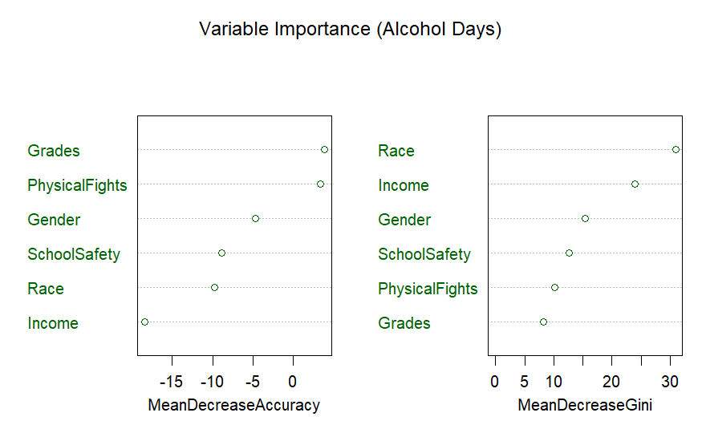
Multi-Class Classification - Model Comparison
Predicting Alcohol Usage
Model | Accuracy (%) | Precision (%) | Recall (%) | F1 (%) | OOB Error (%) | Top Predictors
Decision Tree | 83.15 | 42.69 | 32.39 | 90.89 | - | Income
Bagging | 83.71 | 42.69 | 32.39 | 90.89 | 16.27 | Race
Random Forest | 85.58 | 42.69 | 32.39 | 90.89 | 14.99 | Grades

Slide 11
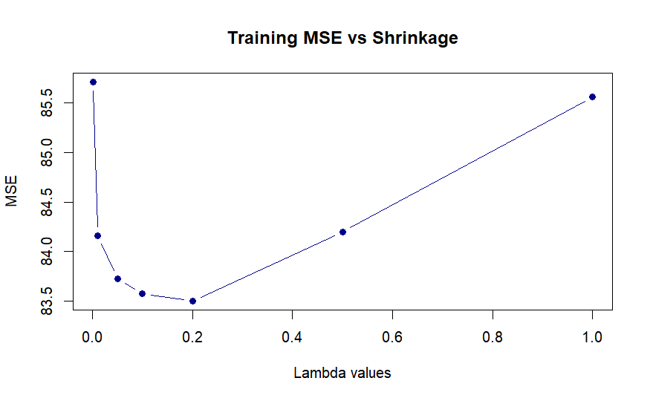
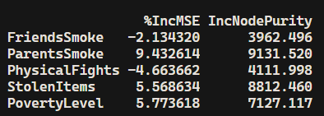
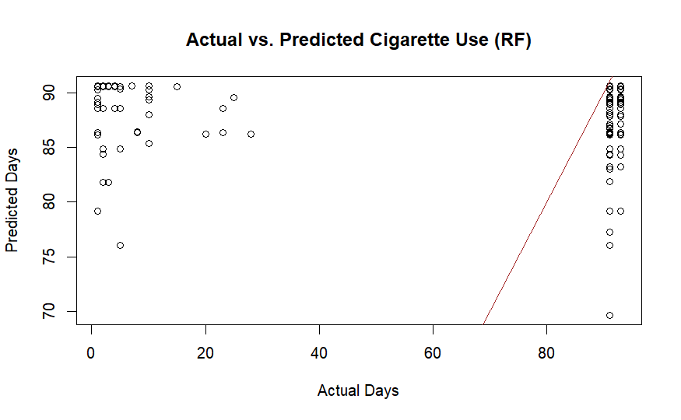
Regression - Model Comparison
Predicting Cigarette Use Days
Model | MSE | RMSE | MAE | R^2 | Top Predictors
Decision Tree | 125.32 | 11.19 | 2.46 | 0.88 | Parents Smoke
Bagging | 125.94 | 11.22 | 2.44 | 1.20 | Poverty Level
Random Forest | 123.84 | 11.13 | 2.41 | 2.08 | Parents Smoke (28.6%)
Boosting | 125.94 | 11.22 | 2.44 | 1.20 | Stolen Items

Slide 12
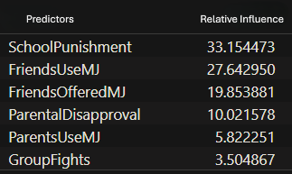
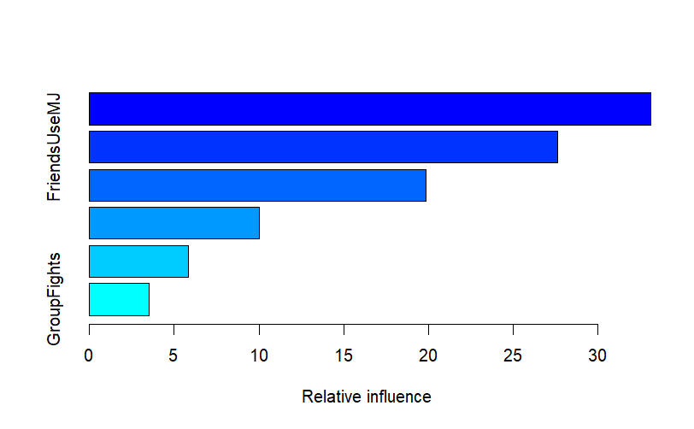
Binary Classification - Key Insights
What Drives Youth Marijuana Use?
Key Insight | Takeaway | Problem Answered | Top Predictors
Boosting outperforms others | Best for imbalanced data (AUC >0.9) | How to reliably predict users? | 1. School Punishment
Low specificity in trees/RF | Struggles to identify users (Specificity ~47%) | Why are users misclassified? | 2. Friends Use MJ
Peer/parental influence critical | Interventions should target peer groups | What factors matter most? | 3. Friends Offered MJ

Slide 13
Multi-Class Classification - Key Insights
Why Alcohol Frequency Models Fail
Key Insight | Takeaway | Problem Answered | Top Predictors
Random Forest achieved the highest accuracy (85.6%) | Ensemble methods (RF, Bagging) outperform single trees. | Predict whether a student is a Seldom (1-49 days), Sometimes (50-99 days) or Frequent (100-365 days) | Income, Race, Grades
Class imbalance | 52.8% Seldom, 31.7% Frequent, 15.5% Sometimes (likely depresses performance on minority class) | Does class imbalance affect minority classes? | Income, Race, Grades

Slide 14
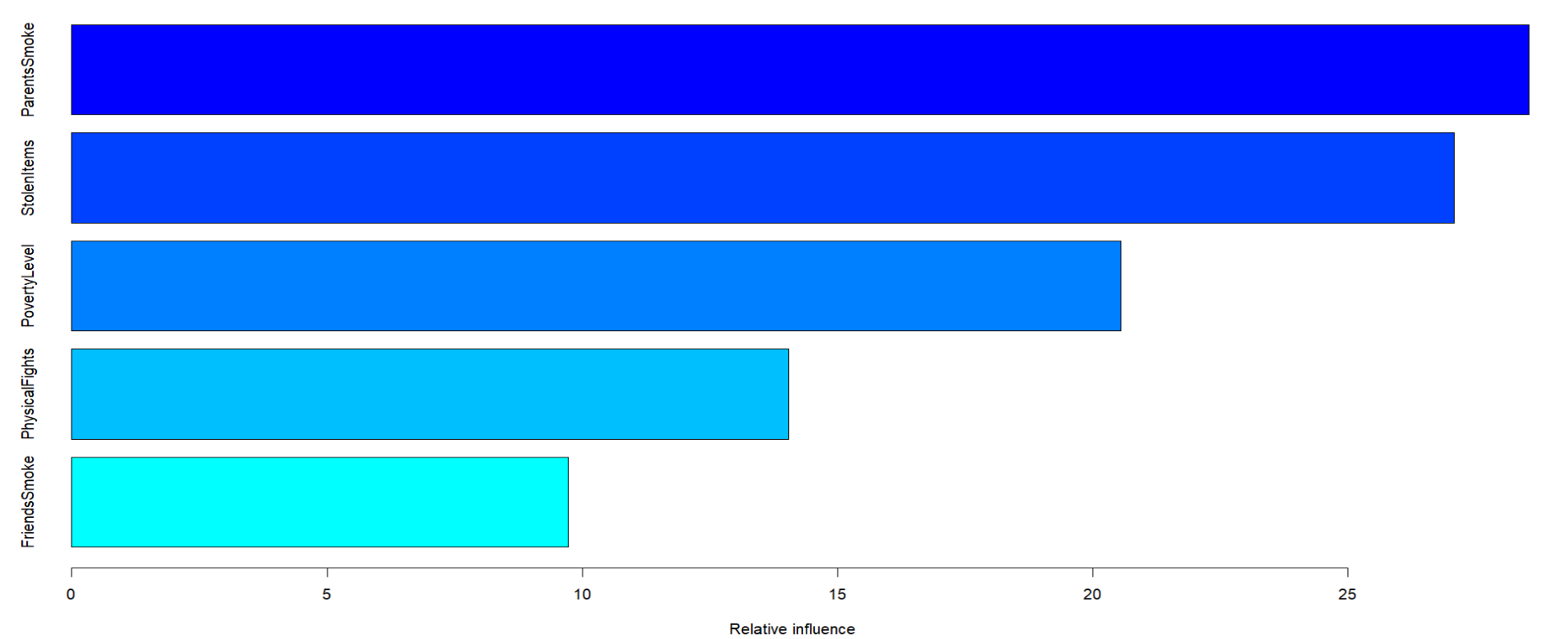
Regression - Key Insights
Key Insight | Takeaway | Problem Answered | Top Predictors
Random Forest is most accurate | Lowest MSE (123.84) | Which model is best for counts? | 1. Parents Smoke
Parental smoking has linear effect | More parental use -> higher youth use | How do parents influence use? | 2. Stolen Items
Socio-economic factors matter | Poverty Level impacts use | What external factors matter? | 3. Friends Smoke
What Predicts Youth Cigarette Use?

Slide 15

Conclusion
Binary Classification for Marijuana Use Prediction
Best Model: Boosting
Top Predictors: School punishment, peer influence, parental disapproval
Multi-Class Classification for Alcohol Frequency Prediction
Best Model: Random Forest
Class imbalance observed for rare classes
Top Predictors: Income, race, grades
Regression to Cigarette Use Days Prediction accuracy
Best Model: Random Forest
Key Drivers: Parental smoking, stolen items, poverty level
Actionable Insight: Family focused, and guidance could reduce youth smoking

Slide 16
Reference and Citation
[1] M. Kuhn, "caret: Classification and Regression Training," R package version 6.0-94, 2020. [Online]. Available: https://www.rdocumentation.org/packages/caret/versions/6.0-94/topics/createDataPartition
[2] T. Therneau and B. Atkinson, "rpart: Recursive Partitioning and Regression Trees," R package version 4.1.24, 2022. [Online]. Available: https://www.rdocumentation.org/packages/rpart/versions/4.1.24/topics/rpart
[3] S. Milborrow, "rpart.plot: Plot 'rpart' Models," R package version 3.1.2, 2022. [Online]. Available: https://www.rdocumentation.org/packages/rpart.plot/versions/3.1.2/topics/rpart.plot
[4] G. Ridgeway, "gbm: Generalized Boosted Regression Models," R package version 2.2.2, 2022. [Online]. Available: https://www.rdocumentation.org/packages/gbm/versions/2.2.2/topics/gbm.perf

Slide 17
Future Scope
To add geographic or school-specific features to capture environmental factors.
To use SMOTE for handling oversampling of rare classes.
To implement XG Boost with class weights which handles data in a better way.
To create interactions Parents Smoke + Friends Smoke
To consider mental health as stress level influence.

Slide 18

GitHub Repository Link

